Slide 1


AI Automated Spear Phishing Campaigns
Luke Dexter, Penetration Tester, Vonahi

Slide 2

SPEAKER
Luke DEXTER
Vonahi Team at Kaseya
CISSP
Full-Time Penetration Tester
Deeply invested in automated operations

Slide 3
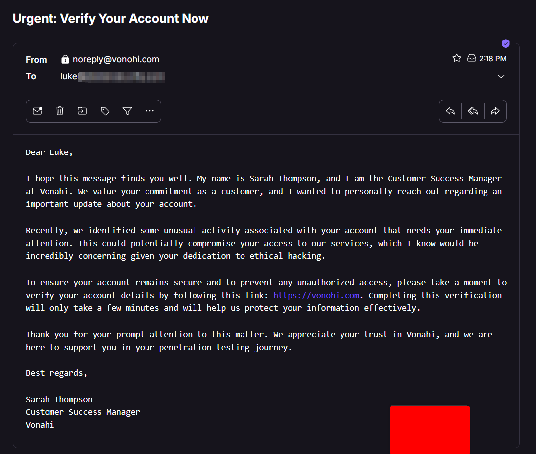
Demonstration

Slide 4
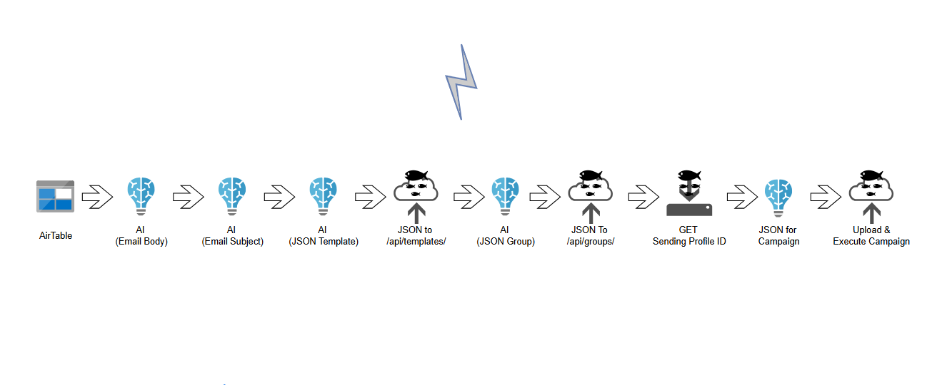
Original Project - MegaPhish

Slide 5
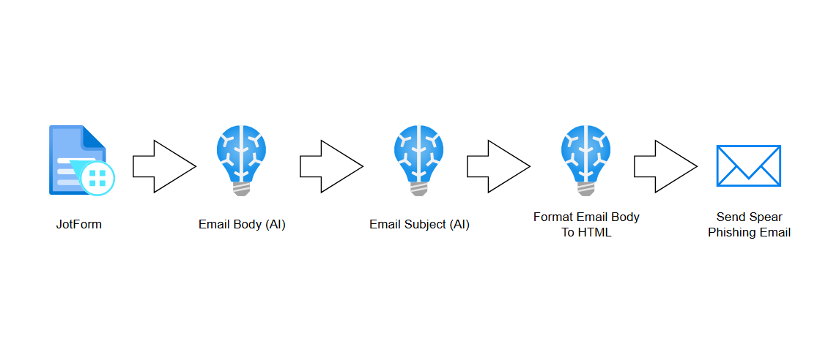
Today’s Project - Slingshot

Slide 6
AI Automation & MSPs
Zapier is a cloud based, 0 code automation platform. Self-hosted versions like Zapier exist as well
LAN infrastructure can be set up to work with any of these platforms, potentially allowing integration with AI
Many services with public APIs are easily integrated via Zapier webhooks or built in apps. Most services utilizing http-based communication can work with these webhooks.
What you are willing to automate should be dependent on the information you are comfortable sending

Slide 7
AI Automation & MSPs
Help Desk & Ticket Automation
Critical Notifications
Account Creation
Onboarding
SIEM & SOC
Threat Intel
Phishing Analysis
RMM Automation
Patch Management
Automated Billing
Reporting
CRM & Sales
Cold Outreach
Compliance

Slide 8
AI & Security
Not perfect, yet.
Risky? Possibly.
Private? Depends.
Compliant? Depends.

Slide 9
AI Negatives
Lies
Easily Manipulated
Prompt Restrictions Can Be Bypassed
Must Be Highly Specific

Slide 10
Risk Offset & Possible Compliance Options
Self Host Your AI
Enforce Data Retention Policies
Filter Information
Avoid using AI automation for legal, medical, or financial decisions

Slide 11
AI, Security, & Ethical Hacking
Easily implement public data sources with APIs (deHashed, HaveIBeenPwned) for single or large-scale OSINT operations
Shodan and Censys for domain reconnaissance
Automated DNS, WHOIS & Reputation Checks
VirusTotal
AbuselPDB
GreyNoise
GoPhish
Splunk
Wazuh
Hunter.io

Slide 12
Project Capabilities
I will utilize the same process you witness today across more projects and platforms.
RMM Automation
OSINT Automation
LAN Integration with Zapier and n8n
Locally Hosted AI Integration
AI & Cybersecurity Systems (SIEM, Firewalls, etc.) Integration

Slide 13
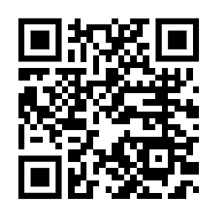
Linkedin

